Slide 1
Physiotherapy
Social Media Toolkit

Slide 2
Introduction
If you work at a site, be it a gym or a hospital, that offers Physiotherapy, promoting the service on their local Facebook page is a great way to increase awareness and generate bookings.
This guide includes advice and suggestions for making the most of your Physio promotion on Facebook, as well as links to further tutorials that can help improve your use of social media.
If you have any questions or need any further advice, please contact Frankie.Murray@nuffieldhealth.com.

Slide 3
Getting access.
  The first step is to speak to the GM/DGM or Sales and Services Manager at your site to check that they are happy for you to have access to the Facebook page, as well as to promote Physiotherapy services.
  Once you have their approval, you will need to “like” the page and contact Frankie.Murray@nuffieldhealth.com with the email address you use to log into Facebook with. You will then be added to the page as an ‘Editor’, which will enable you to post on the site’s Facebook page.
  If you’re unsure of how to use Facebook, please click here to view our handy tutorials that will take you through the basics.

Slide 4
Post ideas.
  Did you know that we offer Physiotherapy with appointments available in as little as 48 hours? To book, visit our website [LINK TO WEBSITE]
  Whether you’ve suffered a sports injury or have a long-term niggle, we offer a full range of Physio treatments that could help. To book an appointment, visit our website [LINK TO WEBSITE]
  Need Physiotherapy, but are worried about the long-term cost? Most of our patients are recovered in 5 sessions or less. To book an appointment, visit our website [LINK TO WEBSITE]
  Curious about Physiotherapy? Our Physio expert [INSERT NAME] will be in the café today to answer any questions you might have.

Slide 5
Physiotherapy content.
As well as posts that advertise Physiotherapy services directly, we also recommend using articles from our suite of content on the Nuffield Health website to help create awareness and offer value for your Facebook followers. These are available to be shared as and when you see fit.
Some of the articles available include:
  4 back pain myths
  What to expect from physiotherapy treatment
  Managing pain with exercise
  How physiotherapy can explain your pain
To browse the full list of articles, visit www.nuffieldhealth.com/article/physiotherapy.

Slide 6
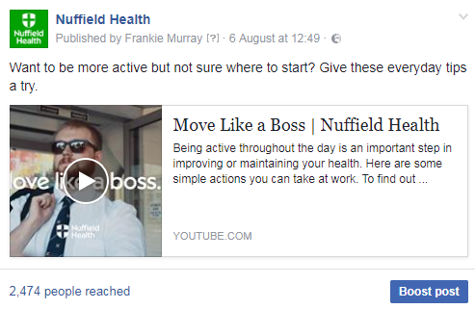
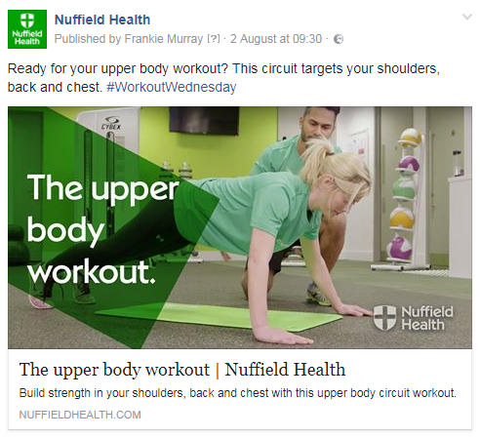
Content examples.

Slide 7
Photo and video tips.
If you have the time and the capacity, you should consider taking photos and recording video of any Physiotherapy advice that the page followers may find useful, e.g. stretches to relieve back pain.
You will also need to make sure that anyone featured in photos of video is happy to be featured on social media before posting.
Photos
When sharing images, always make sure they’re of the highest possible quality – avoid pictures that are blurry, badly lit or distorted
The best size of images on Facebook is 1200x900
If possible, use a high-spec camera for better quality photos
Videos
When recording video on your phone, make sure you film in landscape rather than portrait to capture more detail and fill the screen better
Keep your videos short and snappy – 15 seconds or less is preferable
If possible, use a high-spec camera for better quality video

Slide 8
Further support.
We have a number of handy tutorials to help you make the most of your Facebook page, including:
  Using Facebook
  Facebook advertising
  Encouraging fan growth
  Types of content
  Member communications
  Running competitions
To view these, click here.
For anything else, please contact Frankie.Murray@nuffieldhealth.com.

