Slide 1
Physiotherapy and Fitness Referral Pathways

Slide 2
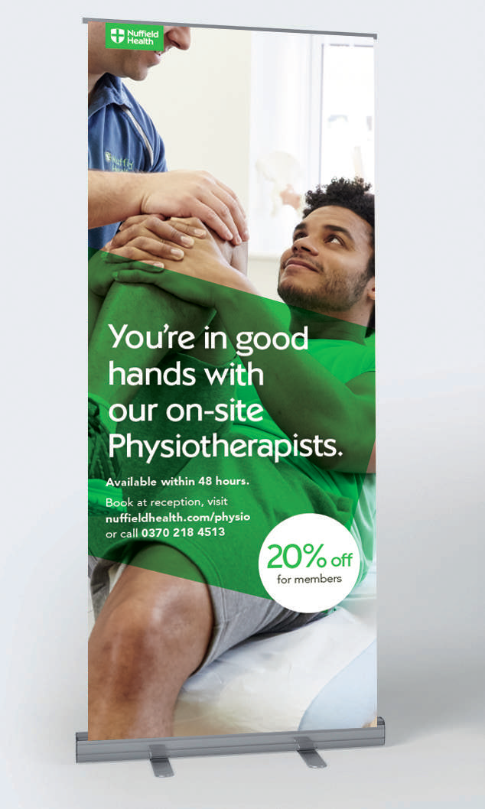
Referral Pathway - Refresh
We are refreshing the Clinical and Fitness Referral pathway for Fitness and Wellbeing Centres.
This is a great opportunity for cross referring between service lines, creating a seamless client journey.
As we already have the 30 day gym pass offering for Physiotherapy patients that are not already members, this referral pathway is available to all.
Key Objectives:
To have the most connected Physio and Fitness business in the UK delivering the best outcomes for our customers. Differentiating our offering and growing additional revenues

Slide 3
Referral Pathway – Action Plan to get the most out of this toolkit
:
Make sure all staff on site are aware of the 2 services
  Physiotherapy (15 min Meet Your Physio, 45 min Initial Consultation, 30 min Follow Up appointment)
  Health MOT (60 min Consultation, available for all members, also available for 30 day members referred from Physio)
Set regular meetings between the Clinical staff and the Fitness staff
  Talk through referrals and any complex cases
Set monthly training between the teams to include
  Physio to talk through common injuries with Fitness Team
  Fitness Team to talk through Health MOT assessments
Referral target to be set. As an example for Week 1
  Fitness Team to book 5 Meet Your Physio sessions following a Health MOT

Slide 4
  Two Main Entry Points between Service Lines
60 min Health MOT
The Health MOT is a one-hour health check carried out by a Wellbeing Personal Trainer, and is designed to give a full picture of the clients health and fitness. The Health MOT measures a number of things including: Body mass index (BMI), Resting heart rate, Waist to hip ratio, Cholesterol, Aerobic Fitness, Blood Pressure, Blood sugar level. Plus during the Health MOT, expert advice will be offered on current exercise regime, any health concerns, existing injuries, stress levels and quality of sleep
15 min Meet your Physio
This appointment is an initial introduction to the onsite Physiotherapist. It is key to establish that this is clearly a conversation. The Physiotherapist will not offer any treatment, will not make a diagnosis, and will not examine the client. The appointment is primarily used as a meet and greet between the Physiotherapist and client, and recommendations will be offered to the client as to whether the Physiotherapy service is the right one, or direct them to the most appropriate service

Slide 5
  Physiotherapy – Referrals into Fitness
Once the IA is completed, the Physiotherapist walks patient to Reception
Receptionist books the follow up appointment with the Physiotherapist and takes payment
If consent is given, the Physiotherapist and PT will discuss prior to the MOT
If consent is given, the results are discussed between the Physiotherapist and PT
Receptionist books patient in for an induction and Health MOT, prior to their next Physiotherapy session, outlining what the MOT will involve
An appropriate fitness programme is designed and delivered
Physiotherapy Initial Appointment
Follow Up and Health MOT Appointment
Review
Key Objectives for this referral pathway to be successful
Time available for Physiotherapist to walk patient to reception
Reception staff all have TM2 log ins
Reception staff have all completed TM2 training
Time available for Physiotherapist and PT to discuss prior and post MOT appointment for complex cases
Multi-disciplinary meeting to be inserted weekly

Slide 6
  Fitness – Referrals into Physiotherapy
Once appointment is completed, Wellbeing Personal Trainer walks client to reception
Receptionist books client in for an Meet your Physio appointment on TM2
If consent is given, the PT and Physiotherapist will discuss prior to the appointment
If consent is given, the results are discussed between the Physiotherapist and PT
Receptionist outlines what the appointment will involve
An appropriate fitness programme is designed and delivered and course of Physiotherapy is booked if required
Health MOT Appointment
Meet your Physio Appointment
Review
Key Objectives for this referral pathway to be successful
Time available for Wellbeing Personal Trainer to walk patient to reception
Reception staff all have TM2 log ins
Reception staff have all completed TM2 training
Time available for Physiotherapist and PT to discuss prior and post MOT appointment for complex cases
Multi-disciplinary meeting to be inserted weekly

Slide 7
Tracking
The cross sell report that is generated and sent daily to all GM’s should be used to create a further spread sheet as set out below
Cross-sell Opportunity 30 day pass
Name | Contact No | Clinical Contact | Date of Activation | Induction date | HMOT date | 7 day call | 21 day call | Member conversion date
A further report is being worked on that incorporates Physiotherapy, MOT bookings, and memberships. As soon as this has been tested and approved we will provide you with this data
A multi-disciplinary meeting is to be set up to go through the report and discuss any advanced cases

Slide 8
Team Briefing
Roll out to all HOD’s at your next team meeting
HOD’s to disseminate to their teams in face to face meeting
Additional meeting to be arranged with the Fitness Team and the Physiotherapy Team
All Front of House staff and Physio’s to be provided with TM2 training on taking payment and log ins
    Log into Academy Online and click on Learning Directory
    In Programme Search type TM2 and search
    3 modules will appear. You must complete all 3 modules:
      TM2 Accepting Advanced Payments
      TM2 Taking payments
      TM2 How to invoice
If you require further training
    Webinar training takes place every Wednesday between 9am – 11am
    Please contact Lindsey Foyle to book training

Slide 9
Document Title: Physiotherapy and Fitness Referral Pathways
Document Classification: Restricted
Document Author: Dannii Sharp
Approved By: Chris Foster
Master Document Location: Physiotherapy Operations
Issue Date: Jun 2017
Review Date: Dec 2017
Version: 1

Slide 10
Thank you.
Dannii Sharp
Physiotherapy Operations Lead
Dannii.sharp@nuffieldhealth.com
Rick Crawford
Fitness Director
Rick.crawford@nuffieldhealth.com
John Doyle
National Physiotherapy Lead
John.doyle@nuffieldhealth.com

