Slide 1
Physiotherapy Payments

Slide 2
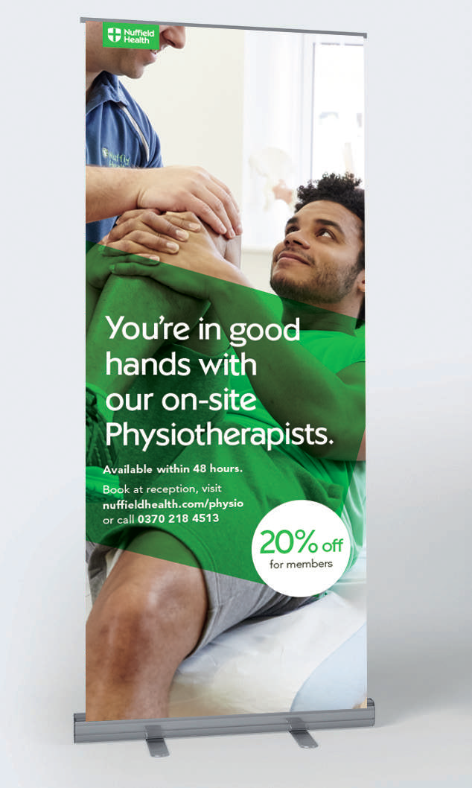
Introduction
This toolkit will go through all the various methods of processing payments through the TM2 application, known as EPDQ.
Anyone with access to TM2 will be able to process a payment. Card payments can also be processed through the TM2 application and will always be the preferred method of payment, but this does not restrict any other types of payment.
Key Objectives:
To have all Nuffield Physiotherapy Patients making payment at the time of booking, eliminating appointment debt and the need to chase DNA and Excess Payments.

Slide 3
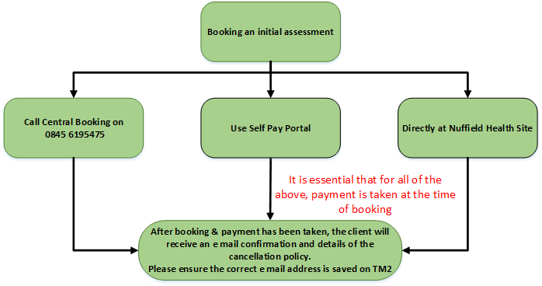
Appointment Pathways

Slide 4
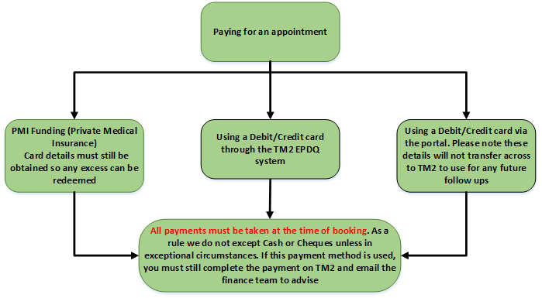
Payment Pathways

Slide 5
Included in the toolkit – Payments
How to register the credit/debit card
How to process a payment, before the appointment has been completed
How to process payment, when completing an appointment
How to print or email receipts
How to process a payment, when the patient has received an invoice
End of day reconciliation

Slide 6
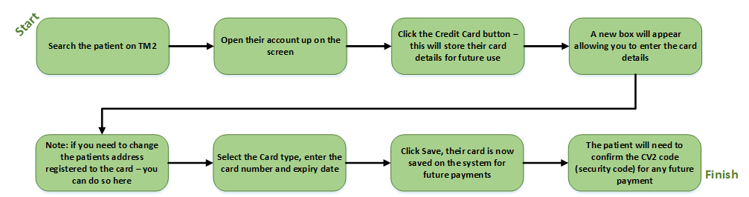
How to register a card to a patient’s record
This should be completed by the front of house or physios at the time of booking the self pay initial appointment.
It is important that any patient who is having treatment funded by their PMI, card details are also taken for excess purposes
NOTE: The accounts team send invoices out on the 15th and 30th of every month, if a patient has not paid the balance within the 10 days of the invoice being issued, Nuffield take payment from these card details we have captured on the system

Slide 7
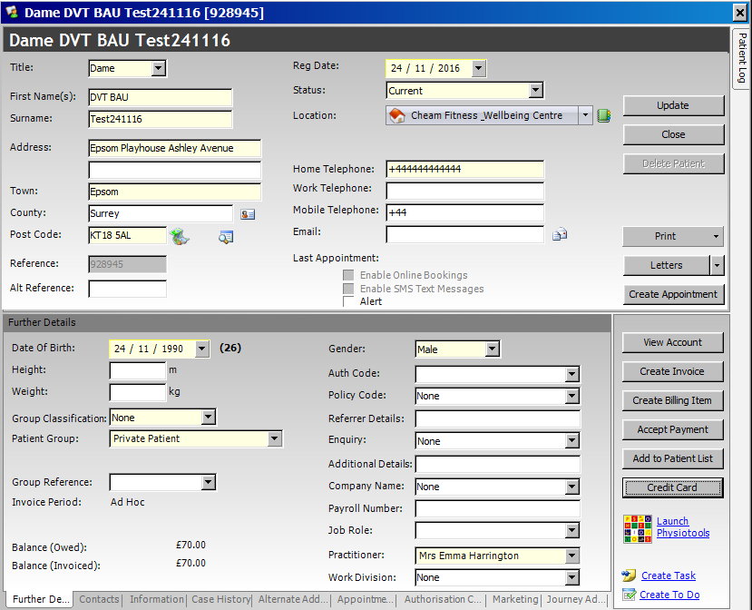
Registering a Card to the Patient’s account
Once you’ve entered the patient’s account and you’re viewing the profile, the “Credit Card” button on the bottom right will enable you to register the patients card for future use.

Slide 8
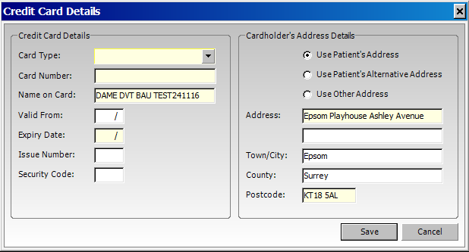
Continued…
Click on the “Credit Card” button and the card details window will open.
The address will automatically import, but you can change it if necessary.
You will then need to enter the card details, ensuring that you’ve selected the correct card type.
Once you’ve entered the card details, click on the “Save” button to exit.
The details are now saved for future use. The patient will need to confirm the CV2 code (security code) for every future payment

Slide 9
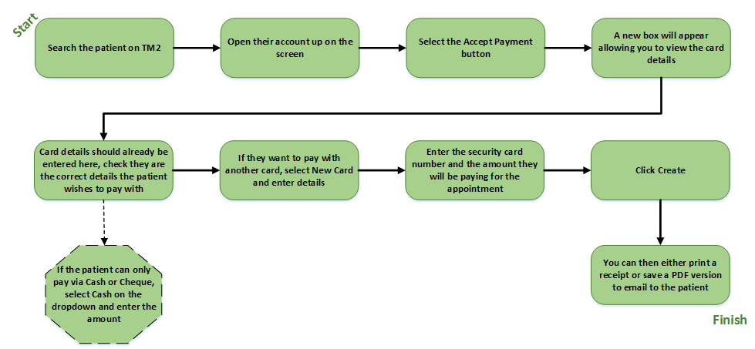
Take payment before appointment has been completed
This is the ideal scenario for taking a payment for all physiotherapy appointments

Slide 10
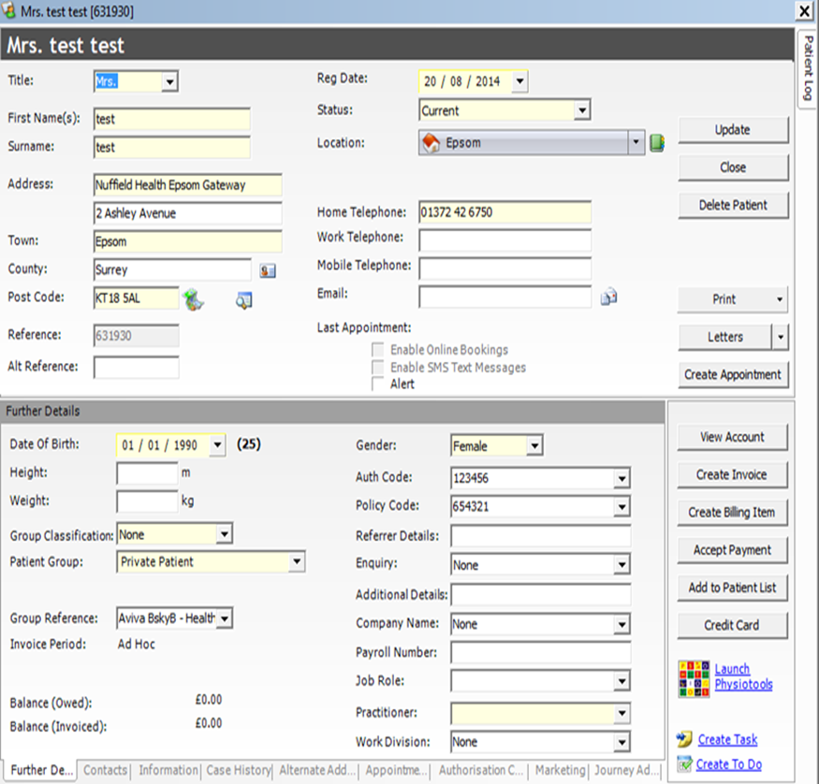
How to process a payment, before the appointment has been completed.
If the patient has not yet had their appointment and they request to make payment beforehand, you can process the payment but you’ll need to be certain of the amount before proceeding.
Once you’ve identified the patient in TM2 and accessed their account, you will then need to select “Accept Payment” on the bottom right as shown in the picture.

Slide 11
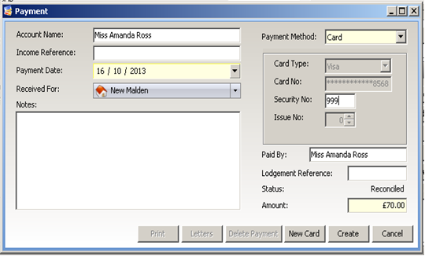
Continued…
Once you’ve arrived at the payment screen, you can select the payment method. If the patient is paying by cash or cheque, select “Cash” as the payment method and then enter the amount they wish to pay and then click “Create”.
If the payment method is a card, you will see any evidence of a pre-existing card. You must verify with the patient if they want to use the same card and confirm the last four digits.
If they are happy to proceed with the same card, you’ll need to enter the “Security No:” which is on the reverse of the card (CV2 code). You will need to enter the amount before you click, on the “Create” tab.

Slide 12
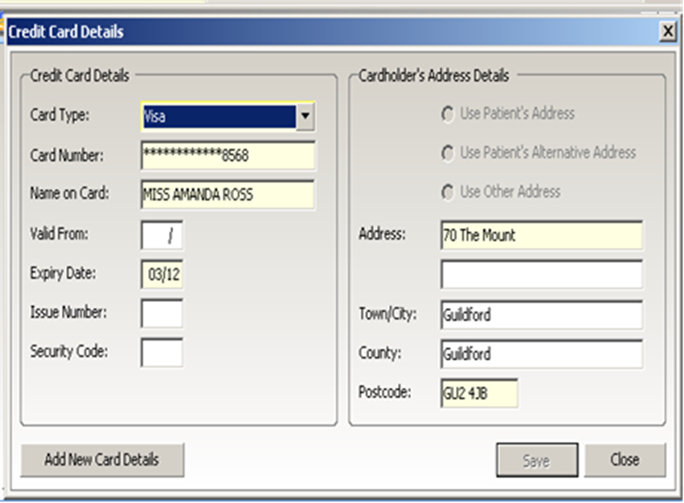
Continued…
If there are no valid/pre-existing card details, you’ll need to enter new card details by changing the payment method to “Card” (at the top right of the payment screen) and then select “New Card”.
This will take you to the card details input screen. You’ll need to select the card type, then entre the full 16 digit card number, the expiry date and then the Security/CV2 code. Click the “Save” button and to exit the screen.
You’ll then be reverted back to the payment screen. The card number will automatically be encrypted and will only show the last four digits.
Click “Create” in order to process the card payment.
Once the payment has been processed you’ll be presented with the option to print a copy of the receipt. If there is no request for a copy of the receipt select “No”.

Slide 13
The payment will now be displayed as a credit balance on the patient’s account and when the appointment has been marked as completed, there will be an option to automatically allocate the payment to the invoice. Please do not print any receipts before the payment has been allocated, as there would be little information displayed on the receipt.

Slide 14
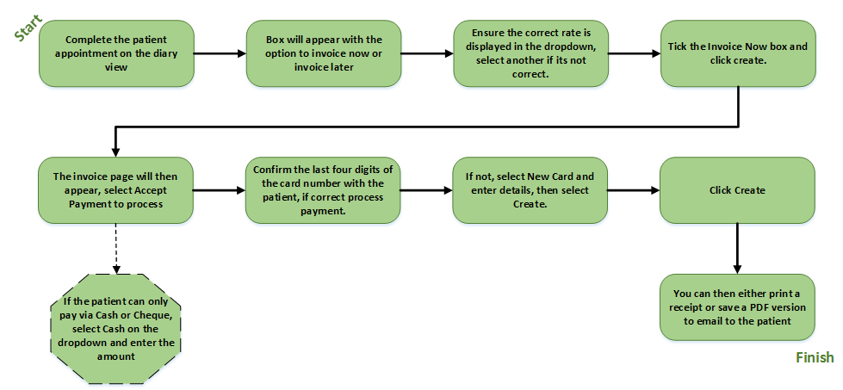
Appointment has been completed but no payment was taken at the point of booking

Slide 15
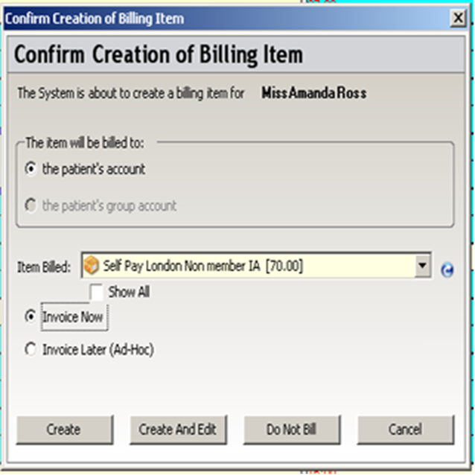
How to process payment, when completing an appointment.
When completing an appointment, you will be presented with the option to “Invoice Now” or “Invoice Later”
Before processing the payment you must ensure that the correct rate has been applied for the patient.
If the correct rate is not displayed, please use the dropdown tab and select the correct rate. Select “Invoice Now” and then “Create”.

Slide 16
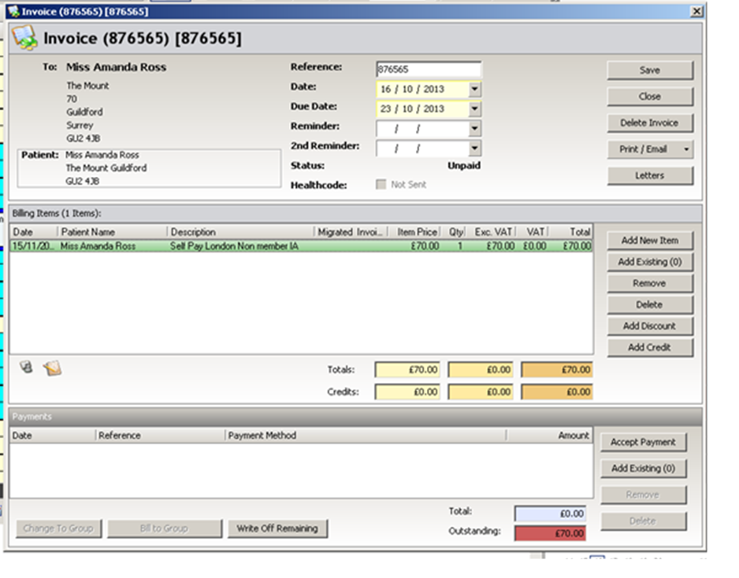
Continued…
When you’ve selected “Invoice Now”, it will take you to the invoice screen as shown here.
You are now able to process the payment. Select “Accept Payment” show on the bottom right, this will take you to the payment screen.

Slide 17

Continued…
Once you’ve arrived at the payment screen, you can select the payment method. If the patient is paying by cash or cheque, select “Cash” as the payment method and then click “Create”. If the payment method is a card, you will be able to process if an existing card is on the system.
You must verify with the patient if they want to use the same card and confirm the last four digits. If they are happy to proceed with the same card, you’ll need to enter the “Security No:” which is on the reverse of the card (CV2 code) and then click on the “Create” button.

Slide 18
Continued…
If there are no valid/pre-existing card details, you’ll need to enter new card details by changing the payment method to “Card” (at the top right of the payment screen) and then select “New Card”.
This will take you to the card details input screen. You’ll need to select the card type, then entre the full 16 digit card number, the expiry date and then the Security/CV2 code. Click the “Save” button, to exit the screen.
You’ll then be reverted back to the payment screen. The card number will automatically be encrypted and will only show the last four digits. Click “Create” in order to process the card payment.

Slide 19
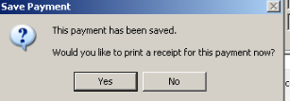
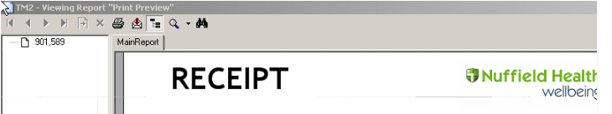
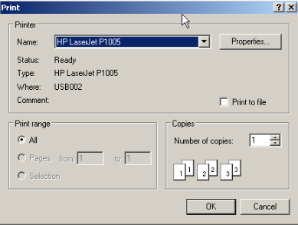
Receipts…
Once the payment has been processed you’ll be presented with the option to print a copy of the receipt. If there is no request for a copy of the receipt select “No” and the window will close and take you back to the invoice window.
To save as PFD to email
To print
If yes then print the receipt out or save as a PDF copy and email to the patient.
You should now see that the invoice has been fully settled.

Slide 20
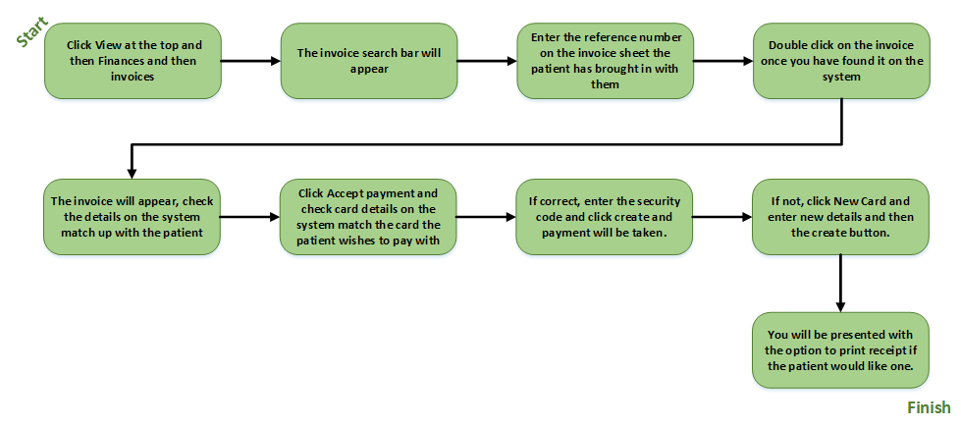
If a patient comes into site with an invoice for DNA/Excess or to pay for an appointment

Slide 21
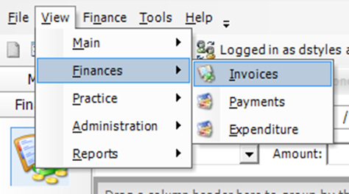
How to process a payment, when the patient has received an invoice.
If the patient is in receipt of an invoice that has been addressed to them and they wish to make payment, you can process the payment from the invoice search window.
On the View tab at the top left, select “Finances” and then “Invoices” as show below.

Slide 22
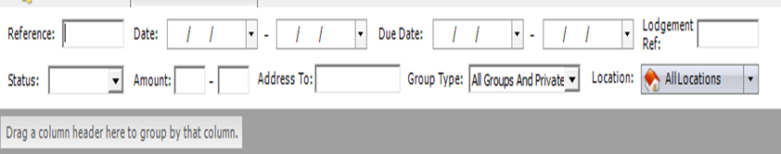
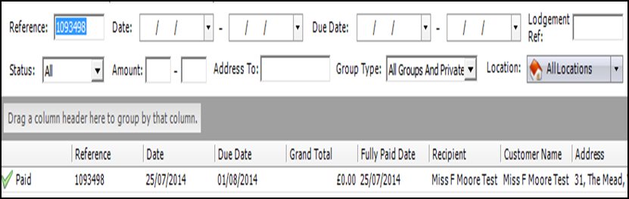
Continued…
You will be directed to the invoice search window. You’ll need to enter the invoice reference in the “Reference” box at the top left and then select “Search” at the top right.
You will then see the invoice displayed below. In order to process the payment, you will need to open the invoice by double clicking the left button on your mouse on the invoice reference number (shown on the right).

Slide 23
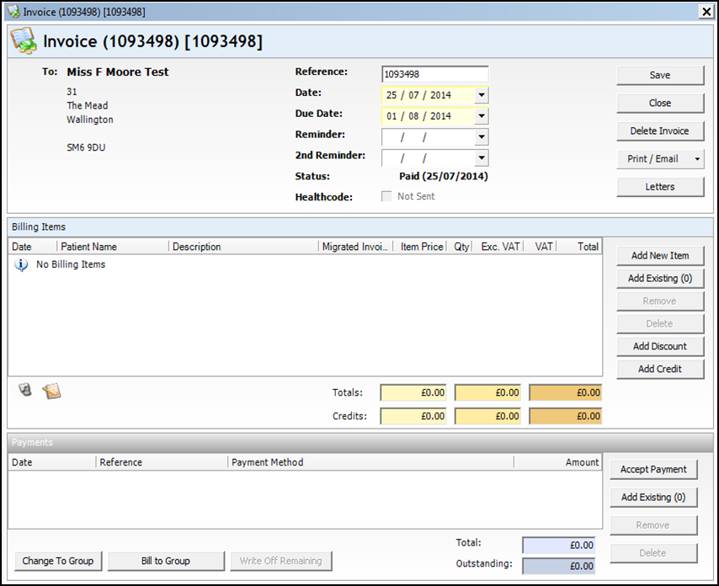
Continued…
A new window will open showing the invoice and details. If the patient name appears in the top left of the window, you can proceed with the payment. If not, please inform the patient we have not received any instruction to rebill the invoice. The liability still remains with the addressee of the invoice.
Click on the “Accept Payment” button on the bottom left, to proceed to the payment processing screen

Slide 24
Continued…
Once you’ve arrived at the payment screen, you can select the payment method
If the patient is paying by cash or cheque, select “Cash” as the payment method and then click “Create”. If the payment method is a card, you will see any evidence of a
pre-existing card. You must verify with the patient if they want to use the same card
and confirm the last four digits. If they are happy to proceed with the same card, you’ll need to enter the “Security No:” which is on the reverse of the card (CV2 code) and then click on the “Create” button.

Slide 25
Continued…
If there are no valid/pre-existing card details, you’ll need to enter new card details by changing the payment method to “Card” (at the top right of the payment screen) and then select “New Card”.
This will take you to the card details input screen. You’ll need to select the card type, then entre the full 16 digit card number, the expiry date and then the Security/CV2 code. Click the “Save” button, to exit the screen. You’ll then be reverted back to the payment screen.
The card number will automatically be encrypted and will only show the last four digits. Click “Create” in order to process the card payment.

Slide 26
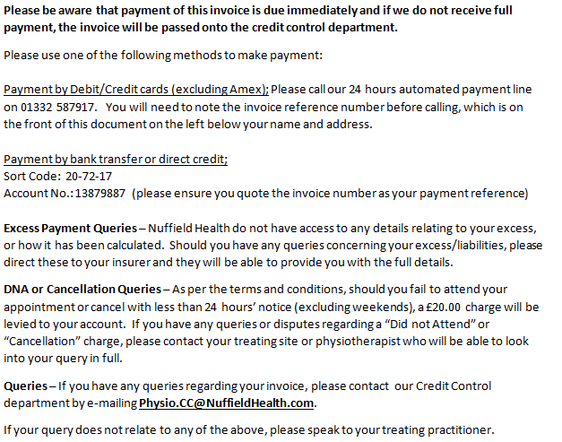
Invoice Information
When an invoice is printed by Finance, they print double sided with further information for the patient, for your
reference here is what is printed on the back of all invoices.

Slide 27
Cash or Cheque taken as a payment?
On the rare occasion that cash or a cheque has been taken, end of day reconciliation must be completed to ensure the money is assigned to the correct invoice.
Follow the above steps using the Cash button on the payment page and take the money however the below must be completed.
We will go through all the steps of completing the daily reconciliation and how you can retrieve this information from TM2.
On the View tab at the top left, select “Reports” and then “Diary” as show below.

Slide 28
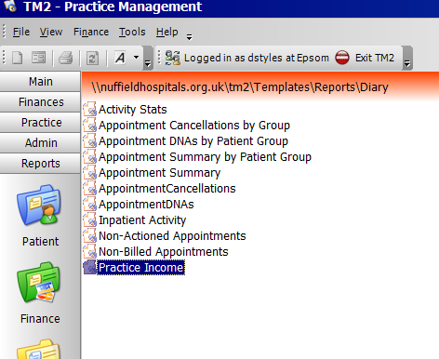
Continued…
The window should display a list of report as displayed on the right.
Double left click on the “Practice Income” report which should open a new widow.
You will need to enter the date range for the report. Todays date will automatically populate.
Then you’ll need to select yes to “Show Detail for every transaction”.
Finally, you will need to select yes to “Include Daily Totals” and then click finish.

Slide 29
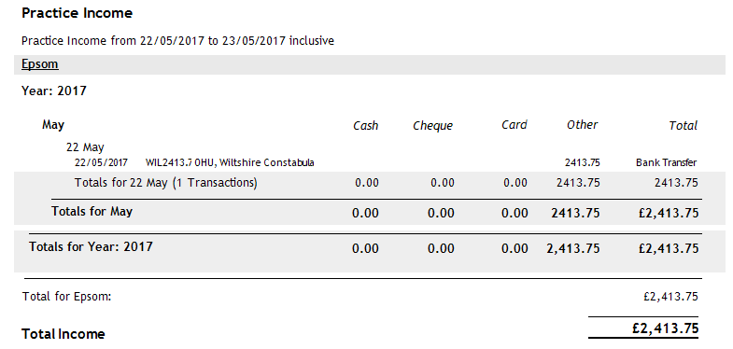

Continued…
You will then be presented with the practice income report as displayed on the right. You will see a full breakdown of all payment transactions for your location and which account they were assigned to.
You can then export the report to excel by selecting the export button at the top left as shown below.
The daily totals in your “Cash” column should match the total value for all the cash and cheque payments taken.
You should contact the finance team if there are any discrepancies.

Slide 30
Scenario’s
Please find some useful scenario’s below that outline the correct step by step guides from the different sources of patient bookings:
Scenario 1 - A Patient who has PMI is booked in to a Physiotherapists diary via the CBO team:
Step by step guide
  Patient attends Initial Appointment
  Patient completes consent form
  Debit/Credit Card details are entered in to TM2
  The Initial Appointment is conducted
  The Debit/Credit card details will only be used for Excess/DNA charges
  Note the patient may ask why payment details are being collected for a second time. This is due to the fact we are unable to share data from the booking system to the application used in the treatment room

Slide 31
Scenario’s
Scenario 2 - A self pay patient attends a face to face initial appointment after booking the initial appointment via the NH website
Step by step guide
  Patient attends Initial Appointment
  Patient completes consent form
  Debit/Credit Card details are entered in to TM2
  The Initial Appointment is conducted
  The payment will need to be processed at site
  Note the patient may ask why payment details are being collected for a second time. This is due to the fact we are unable to share data from the booking system to the application used in the treatment room

Slide 32
Scenario’s
Scenario 3 - A patient attends a Physiotherapy initial appointment following a surgical procedure and is receiving Physiotherapy under a package price
Step by step guide
  Patient attends Initial Appointment
  Patient completes consent form
  Debit/Credit Card details are entered in to TM2
  The Initial Appointment is conducted
  The Debit/Credit card details will only be used for DNA charges
  Note the patient may ask why payment details are being collected for a second time. This is due to the fact we are unable to share data from the booking system to the application used in the treatment room
·

Slide 33
Thank you.
Dannii Sharp
Physiotherapy Operations Lead
Sian Diprose
Physiotherapy Business Partner
Damian Style
Physiotherapy Finance

